Slide 1
Chapter 24: Network Assurance
Instructor Materials
CCNP Enterprise: Core Networking

Slide 2
Chapter 24 Content
This chapter covers the following content:
Network Diagnostic Tools - This section covers the common use cases and operations of ping, traceroute, SNMP, and syslog.
Debugging - This section describes the value of using debugging as a troubleshooting tool and provides basic configuration examples.
NetFlow and Flexible NetFlow - This section examines the benefits and operations of NetFlow and Flexible NetFlow.
Switched Port Analyzer (SPAN Technologies) - This section examines the benefits and operations of SPAN, RSPAN, and ERSPAN.
IP SLA - This section covers IP SLA and the value of automated network probes and monitoring.
Cisco DNA Center Assurance - This section provides a high-level overview of Cisco DNA Center Assurance and associated workflows for troubleshooting and diagnostics.

Slide 3
Network Diagnostic Tools
Many network diagnostic tools are readily available. This section covers some of the most common tools available and provides use cases and examples of when to use them.

Slide 4
Network Diagnostic Tools Ping
Ping is one of the most useful troubleshooting.
The following troubleshooting flow is a quick way to check reachability and try to determine what the issue may be:
Step 1. Gather the facts.
Step 2. Test reachability by using the ping command.
Step 3. Record the outcome of the ping command and move to the next troubleshooting step. If ping is successful, then the issue isn’t likely related to basic reachability. If ping is unsuccessful, the next step could be checking something more advanced, such as interface issues, routing issues, access lists, or intermediate firewalls.

Slide 5
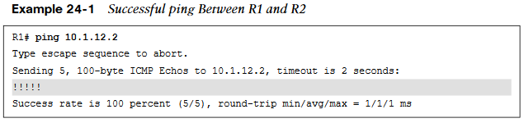
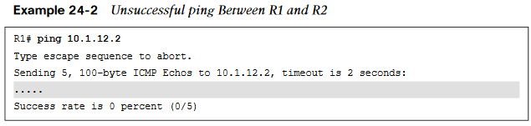
Network Diagnostic Tools Successful and Unsuccessful Pings
Example 24-1 illustrates a successful ping between R1 and R2. This example shows five 100-byte ICMP echo request packets sent to 10.1.12.2 with a 2-second timeout. The result is five exclamation points (!!!!!).
It is important to illustrate what an unsuccessful ping looks like as well. Example 24-2 shows an unsuccessful ping to R2’s Ethernet0/0 interface with an IP address of 10.1.12.2.

Slide 6
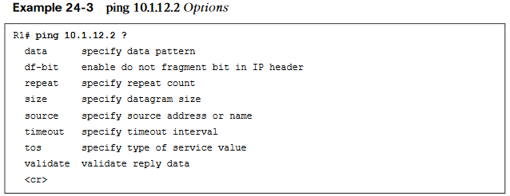
Network Diagnostic Tools Ping Options
The ping command can be changed and manipulated to aid in troubleshooting. Example 24-3 shows some of the available options for the ping command on a Cisco device. These options can be seen by using the context sensitive help (?) after the IP address that follows the ping command. This section specifically focuses on the repeat, size, and source options.

Slide 7
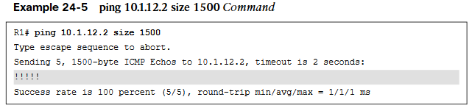
Network Diagnostic Tools Ping Size
Another very common use case for the ping command is to send different sizes of packets to a destination. An example might be to send 1500-byte packets with the DF bit set to make sure there are no MTU issues on the interfaces or to test different quality of service policies that restrict certain packet sizes. Example 24-5 shows a ping destined to R2’s Ethernet0/0 interface with an IP address 10.1.12.2 and a packet size of 1500 bytes.

Slide 8
Network Diagnostic Tools Extended Ping Options
An extended ping can take advantage of the same options already discussed, as well as some more detailed options for troubleshooting. These options are listed in Table 24-2.
Option | Description
Protocol | IP, Novell, AppleTalk, CLNS, and so on; the default is IP
Target IP address | Destination IP address of ping packets
Repeat Count | Number of ping packets sent; the default is 5 packets
Datagram Size | Size of the ping packet; the default is 100 bytes
Timeout in seconds | How long a echo reply response is waited for
Extended Commands | Yes or No to use extended commands; the default is No, but if Yes is used, more options become available
Source Address or Interface | IP address of the source interface or the interface name

Slide 9
Network Diagnostic Tools Extended Ping Options (Cont.)
Option | Description
Type of Service (ToS) | The Type of Service to be used for each probe; 0 is the default
Set DF bit in IP header | Sets the Do Not Fragment bit in the IP header; the default is No
Data Pattern | The data pattern used in the ping packets; the default is 0xABCD
Loose, Strict, Record, Timestamp, Verbose | The options set for the ping packets: Loose - Specifies hops that ping packets should traverse Strict - Same as Loose with the exception that packets can only traverse specified hops Record - Displays IP addresses of first nine hops that the ping packets traverse Timestamp - Displays the round-trip time to the destination for each ping Verbose - Default option that is automatically selected with any and all other options

Slide 10
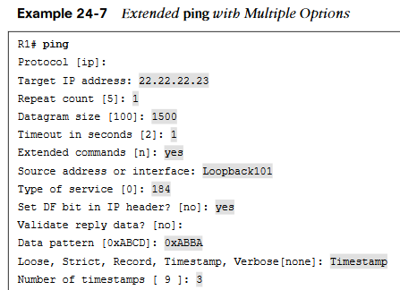
Network Diagnostic Tools Extended Ping with Multiple Options
Setting the MTU in an extended ping and setting the DF bit in the IP header can help determine whether there are MTU settings in the path that are not set appropriately.
With tunneling it is important to account for the overhead of the tunnel technology, which can vary. Specifying a Type of Service of 184 in decimal translates to Expedited Forwarding or (EF) per-hop behavior (PHB). This can be useful when testing real-time quality of service (QoS) policies.
Setting Data Patterns can help when troubleshooting framing errors, line coding, or clock signaling issues on serial interfaces.
Finally, a timestamp is set in this example, in addition to the default Verbose output. This gives a clock timestamp of when the destination sent an echo reply message back to the source.

Slide 11
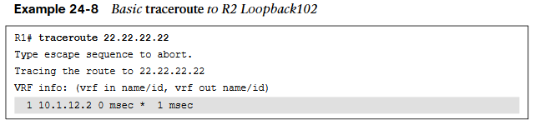
Network Diagnostic Tools Traceroute
Traceroute is often used to troubleshoot when trying to determine where traffic is failing as well as what path traffic takes through-out the network.
Traceroute shows the IP addresses or DNS names of the hops between the source and destination.
It also shows how long it takes to reach the destination at each hop, measured in milliseconds. This tool is frequently used when more than one path is available to the destination or when there is more than one hop to the destination.

Slide 12
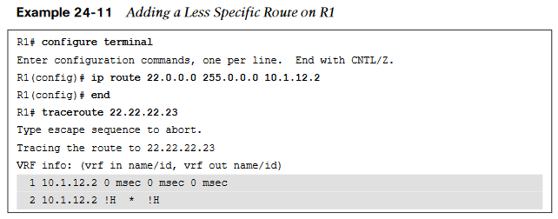
Network Diagnostic Tools Adding a Less Specific Route
A less specific route is added to R1 that points to 22.0.0.0/8 or 22.0.0.0 255.0.0.0, the traceroute returns a “host unreachable” message. This is because there is a route to the next hop, R2 (10.1.12.2), but once the traceroute gets to R2, there is no interface or route to 22.22.22.23/32, and the traceroute fails. Example 24-11 shows this scenario.

Slide 13
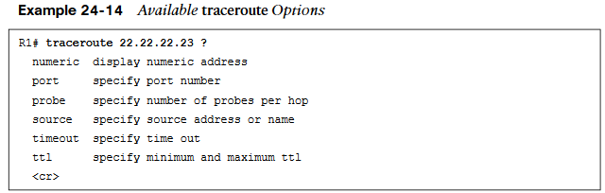
Network Diagnostic Tools Traceroute Options
Another benefit of traceroute is that it has options available. These options can also be discovered by leveraging the context-sensitive help (?) from the command-line interface. Example 24-14 shows the list of available options to the traceroute command.
There are times when using some of the options available with traceroute may be . There are also times when there might be a reason to send a different number of probes per hop with different timeout timers rather than the default of three probes.

Slide 14
Network Diagnostic Tools Extended Traceroute Options
Much like the extended ping command covered earlier in this chapter, there is an extended traceroute command, and it has a number of detailed options available. Those options are listed in Table 24-3.
Option | Description
Protocol | IP, Novell, AppleTalk, CLNS, and so on; the default is IP
Target IP address | Destination IP address of ping packets
Numeric display | Shows only the numeric display rather than numeric and symbolic display
Timeout in Seconds | Time that is waited for a reply to a probe; the default is 3 seconds
Probe count | Number of probes sent at each hop; the default is 3
Source Address | IP address of the source interface

Slide 15
Network Diagnostic Tools Extended Traceroute Options (Cont.)
Option | Description
Minimum Time-to-live | TTL value of the first set of probes; can be used to hide topology information or known hops
Maximum Time-to-live | Maximum number of hops; the default is 30
Port number | Destination port number of probes; the default is 33434
Loose, Strict, Record, Timestamp, Verbose | The options set for the traceroute probes: Loose - Specifies the hops that ping packets should traverse Strict - Same as Loose with the exception that packets can traverse only specified hops Record - Displays IP addresses of the first nine hops that the traceroute packets traverse Timestamp - Displays the round-trip time to the destination for each ping Verbose - Default option that is automatically selected with any and all other options

Slide 16
Debugging
Debugging can be a very powerful part of troubleshooting complex issues in a network.
One of the most common use cases for debugging is when there is a need to see things at a deeper level (such as when routing protocols are having adjacency issues).
There is a normal flow that is taken from a troubleshooting perspective, depending on the routing protocol.

Slide 17
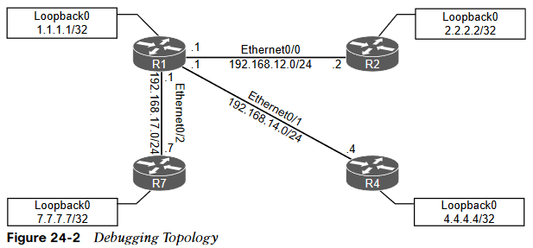
Debugging Debugging Topology
Using the simple topology shown in Figure 24-2, in this section, debugging is used to fix a couple issues in the OSPF area 0.

Slide 18
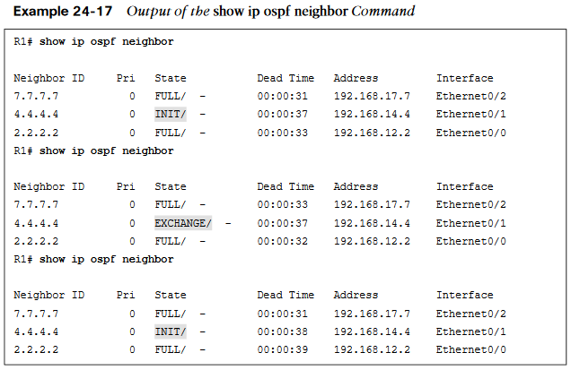
Debugging OSPF Adjacency Issues
Some of the common OSPF adjacency issues such as MTU issues, incorrect interface types, and improperly configured network mask can be resolved by using debugging.
From the output of the show ip ospf neighbor command on R1 in Example 24-17, it can be seen that the neighbor adjacency to R4 is in the INIT state. If the command is run after a few seconds, the state changes to EXCHANGE but quickly cycles back to the INIT state when the command is run again.

Slide 19
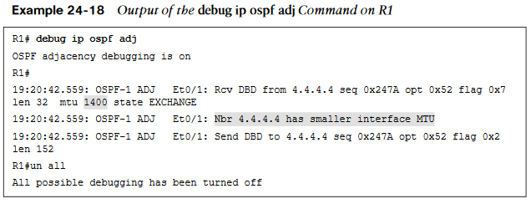
Debugging Output of Debug IP OSPF ADJ Command
Debugging is used on R1 to try to determine what the issue is. Example 24-18 shows the output of the debug ip ospf adj command. This command is used to reveal messages that are exchanged during the OSPF adjacency process.
The output of the debug ip ospf adj command in Example 24-18 clearly states that it received a Database Descriptor packet from the neighbor 4.4.4.4, and that the neighbor 4.4.4.4 has a smaller interface MTU of 1400.

Slide 20
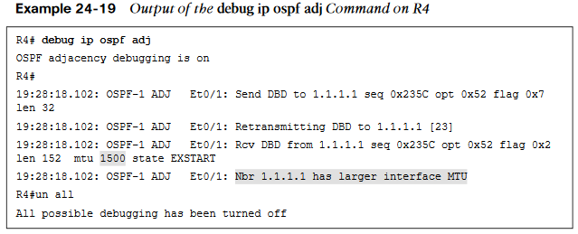
Debugging Output of Debug IP OSPF ADJ Command (Cont.)
Example 24-19 shows the output of the debug ip ospf adj command on R4 with the relevant fields highlighted. The output shows that R1 has an MTU size of 1500, which is larger than the locally configured MTU of 1400 on R4. This is a really quick way of troubleshooting this type of issue with adjacency formation

Slide 21
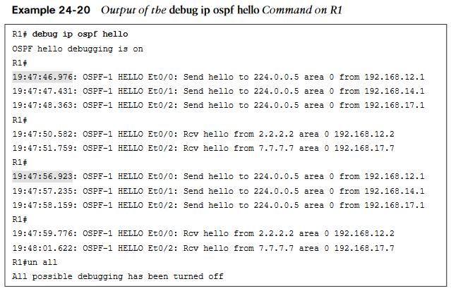
Debugging Output of the Debug IP OSPF Hello Command
The issue with OSPF network type mismatch, which is a very common reason for neighbor adjacency issues. Often this is simply a misconfiguration issue when setting up the network.
When the debug ip ospf hello command is used on R1, everything appears to be normal: Hellos are sent to the multicast group 224.0.0.5 every 10 seconds.
Example 24-20 shows the output of the debug command on R1.

Slide 22
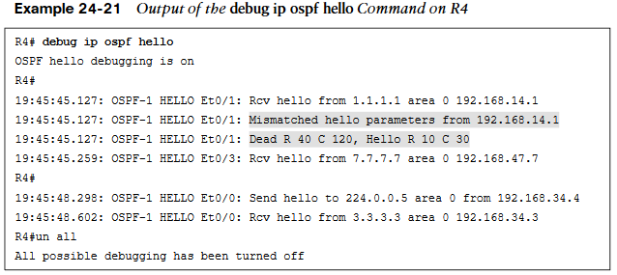
Debugging Output of the Debug IP OSPF Hello Command (Cont.)
Example 24-21 shows the issue output on R4.
Based on the output, we can see that the hello parameters are mismatched. The output shows that R4 is receiving a dead interval of 40, while it has a configured dead interval of 120. We can also see that the hello interval R4 is receiving is 10, and the configured hello interval is 30. By default, the dead interval is 4 times the hello interval.

Slide 23
Debugging Hello and Dead Intervals
Different network types have different hello intervals and dead intervals. Table 24-4 high-lights the different hello and dead interval times based on the different OSPF network types.
Table 24-4 OSPF Network Types and Hello/Dead Intervals
Network Type | Hello Interval (in seconds) | Dead Interval (in seconds)
Broadcast | 10 | 40
Non-broadcast | 30 | 120
Point-to-point | 10 | 40
Point-to-Multipoint | 30 | 120

Slide 24
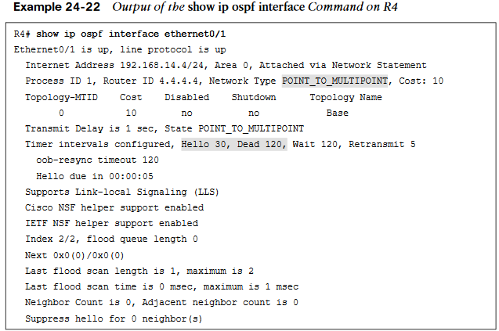
Debugging Output of the Show IP OSPF Interface
The issue could be simply mismatched network types or mismatched hello or dead intervals.
The show ip ospf interface command shows what the configured network types and hello and dead intervals are.
Example 24-22 shows the output of this command on R4.

Slide 25
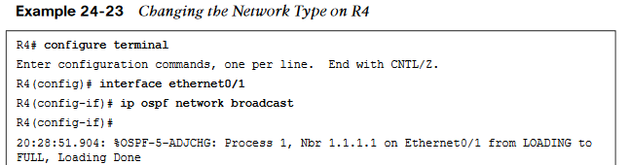
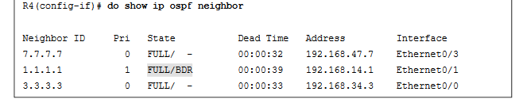
Debugging Changing the Network Type
Simply changing the network type on R4 interface Ethernet0/1 back to the default of Broadcast fixes the adjacency issue in this case. This is because R1 is configured as Broadcast, and now the hello and dead intervals will match.
Example 24-23 shows the ip ospf network-type broadcast command issued to change the network type to Broadcast on the Ethernet0/1 interface and the neighbor adjacency coming up. It is also verified with the do show ip ospf neighbor command.

Slide 26
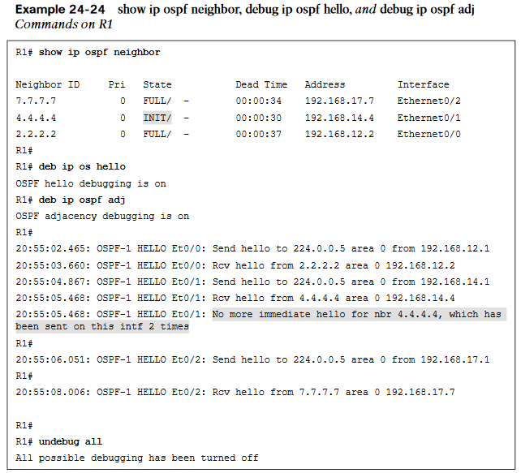
Debugging Show and Debug Commands on R1
The final use case for using debugging to solve OSPF adjacency issues involves improper configuration of IP addresses and subnet masks on an OSPF interface.
To troubleshoot this without having to look through running configurations or at a specific interface, use the debug ip ospf hello command covered earlier in this section.
Example 24-24 shows the output of running the show ip ospf neighbor command on R1. It indicates that there is no OSPF adjacency to R4 when there certainly should be one.

Slide 27
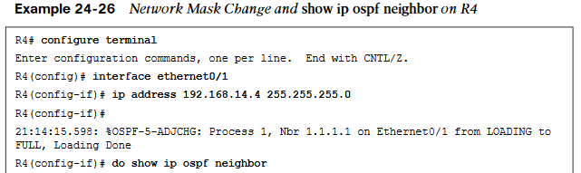
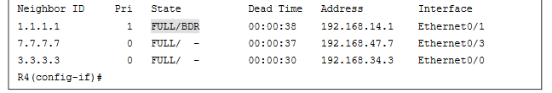
Debugging Ping
The network mask on the Ethernet0/1 interface of R4 needs to be changed to match the one that R1 has configured and is sending to R4 through OSPF hellos.
Example 24-26 shows the network mask being changed on the R4 Ethernet0/1 interface and the OSPF adjacency coming up. This is then verified with the do show ip ospf neighbor command.

Slide 28
Debugging Conditional Debugging
Conditional debugging can be used to limit the scope of the messages that are being returned to the console or syslog server. A great example of this is the debug ip packet command. Issuing this command on a router that is in production could send back a tremendous number of messages.
One way to alleviate this issue is to attach an access list to the debug command to limit the scope of messages to the source or destination specified within the access list. This can be done using standard or extended access lists.
The options for the debug ip packet command are as follows:
<1-199>: Standard access list
<1300-2699>: Access list with expanded range
detail: More debugging detail

Slide 29
Debugging Debugging on a Specific Interface
Another common method of conditional debugging is to debug on a specific interface. This is extremely useful when trying to narrow down a packet flow between two hosts.
Imagine that a network engineer is trying to debug a traffic flow between R1’s Ethernet0/1 interface with source IP address 192.168.14.1/24 that is destined to R4’s Loopback0 interface with IP address 4.4.4.4/32.
One way to do this would certainly be to change the access list 100 to reflect these source and destination IP addresses. However, because the access list is looking for any traffic sourced or destined to the 192.168.14.0/24 network, this traffic flow would fall into matching that access list. Using conditional debugging on the Loopback0 interface of R4 would be a simple way of meeting these requirements.
Even if all debugging has been turned off using the undebug all command, the interface conditions set for Loopback0 on R4 remain. The way to remove this condition is to use the undebug interface loopback0 command on R4.

Slide 30
Debugging Simple Network Management Protocol (SNMP)
The typical tool for reactive alerting from network devices is Simple Network Management Protocol (SNMP).
SNMP sends unsolicited traps to an SNMP collector or network management system (NMS). These traps are in response to something that happened in the network.
For example, traps may be generated for link status events, improper user authentication, and power supply failures. These events are defined in the SNMP Management Information Base (MIB).
The MIB can be thought of as a repository of device parameters that can be used to trigger alerts.

Slide 31
Debugging SNMP Versions
There are currently three versions of SNMP. Table 24-5 lists the versions and their differences.
Table 24-5 SNMP Version Comparison
Version | Level | Authentication | Encryption | Result
SNMPv1 | noAuthNoPriv | Community string | No | Uses a community string match for authentication.
SNMPv2c | noAuthNoPriv | Community string | No | Uses a community string match for authentication.
SNMPv3 | noAuthNoPriv | Username | No | Uses a username match for authentication.
SNMPv3 | authNoPriv | Message Digest 5 (MD5) or Secure Hash Algorithm (SHA) | No | Provides authentication based on the HMAC-MD5 or HMAC-SHA algorithms.

Slide 32
Debugging SNMP Versions (Cont.)
Version | Level | Authentication | Encryption | Result
SNMPv3 | authPriv (requires the cryptographic software image) | MD5 or SHA | No | Provides authentication based on the HMAC-MD5 or HMAC-SHA algorithms. Allows specifying the User-based Security Model (USM) with these encryption algorithms:DES 56-bit encryption in addition to authentication based on the CBC-DES (DES-56) standard.3DES 168-bit encryptionAES 128-bit, 192-bit, or 256-bit encryption

Slide 33
Debugging SNMP Operations
Using SNMP is considered best practice in production. SNMPv1 and SNMPv2c use access lists and a community password or string.
These community strings can be read-only (RO) or read/write (RW). It is critical to limit SNMP access to these devices by using access lists.
By default, if no version is specified in configuration, SNMPv1 is used. However, to better show how SNMP works, this chapter focuses on SNMPv2c.
Operation | Description
get-request | Retrieves a value from a specific variable
get-next-request | Retrieves a value from a variable within a table
get-bulk-request | Retrieves large blocks of data, such as multiple rows in a table
get-response | Replies to a get request, get next request, and set request sent by an NMS
set-request | Stores a value in a specific variable
trap | Sends an unsolicited message from an SNMP agent to an SNMP manager when some event has occurred

Slide 34
Debugging MIBs
It is important to look at a MIB to understand some of the information or values that can be polled or send traps from SNMP.
The SNMPv2-MIB.my file shows what values can be polled in the MIB and to illustrate sending traps from SNMP. To see a list of available Cisco MIBs, visit https://mibs.cloudapps.cisco.com/ITDIT/MIBS/servlet/index.
Although configuring an NMS is not covered in this chapter, the device side that points to an NMS is covered in this section.
The following list shows a handful of measures involved in setting up SNMP on a device to allow the device to be polled and send traps to an NMS:
Define the SNMP host or the NMS to send traps to
Create an access list to restrict access via SNMP
Define the read-only community string
Define the read/write community string
Define the SNMP location
Define the SNMP contact

Slide 35
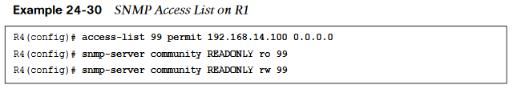
Debugging MIBs (Cont.)
These settings do not need to be configured in any particular order. It is best practice to configure the access list first and then the read-only and read/write strings to have security in place.
On R1, a standard access list is configured to only permit access from an NMS host on the 192.168.14.0/24 subnet, 192.168.14.100. Once the access list is configured, the read-only and read/write community strings are configured and bound to that access list.
It is important to try to use SNMP strings that are not easy to guess from a security perspective.
At this point, the device is configured to be polled from an NMS host with the IP address 192.168.14.100.

Slide 36
Debugging SNMP Traps
To send SNMP traps to an NMS, traps first must be enabled on the device. All available traps can be enabled by issuing the snmp-server enable traps command.
However, this may enable unnecessary traps that have no significance to the network operations team. It might be more appropriate to be selective about which traps to enable.
The traps that are available to be enabled is platform specific.
A common approach to determining what traps are available is to look at the documentation for the device. It may be easier to simply issue the snmp-server enable traps command followed by ? to leverage the context-sensitive help and determine what traps are available on the device.
A significant number of traps can be enabled to send to an NMS.

Slide 37
Debugging Syslog
Devices can generate useful information to the console, to the logging buffer, and to off-box syslog collectors. In fact, all three can be sent the same or different message types.
It is critical to note that prior to configuring any device to send log information, the date and time of the clock must be properly configured for accurate time.
Level Keyword | Level | Description | Syslog Definition
emergencies | 0 | System unstable | LOG_EMERG
alerts | 1 | Immediate action needed | LOG_ALERT
critical | 2 | Critical conditions | LOG_CRIT
errors | 3 | Error conditions | LOG_ERR
warnings | 4 | Warning conditions | LOG_WARNING
notifications | 5 | Normal but significant conditions | LOG_NOTICE
informational | 6 | Informational messages only | LOG_INFO
debugging | 7 | Debugging message | LOG_DEBUG

Slide 38
Debugging Syslog (Cont.)
Having syslog configured doesn’t mean that an issue will be found. It still takes the proper skill to be able to look at the messages and determine the root cause of the issue.
The logging buffer is the first area to focus on. You can enable logging to the buffer as follows:
1. Enable logging to the buffer.
2. Set the severity level of syslog messages to send to the buffer.
3. Set the logging buffer to a larger size.
The logging buffered ? command is issued from the global configuration mode to see the available options. It is important to note that the severity level can be configured by simply specifying the level with a number from 0 to 7 or the name of the severity (listed next to the severity level number).
The default size of the logging buffer is 4096 bytes. This can get overwritten quite quickly. It is good practice to expand the buffer size so you can capture more logging information.

Slide 39
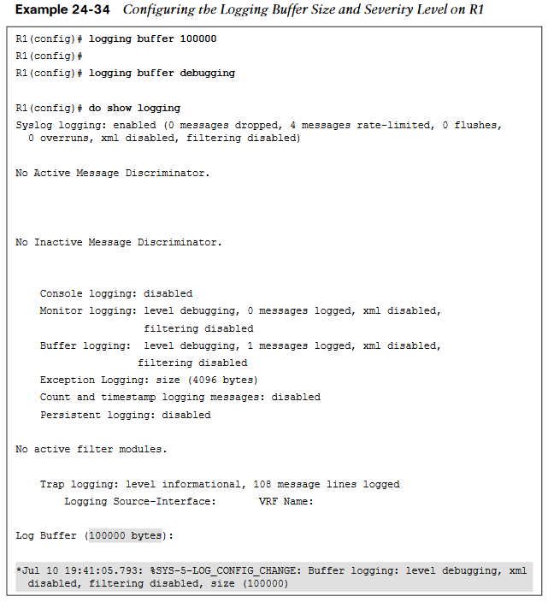
Debugging Logging Buffer Size and Severity Level
Debugging or severity 7 is the level that will be configured in this example; with this configuration, any debugging can be sent to the logging buffer instead of the console.
In Example 24-34, the logging is configured to the debugging level, 7, and it is set to 100000 bytes.

Slide 40
Debugging Sending Logging to a Host for Debugging
Sending these same logs to an off-box collector, that could be configured as well. By default, these messages are sent to the logging host through UDP port 514, but this can be changed if necessary.
Configuring logging to a host is very similar to configuring logging on the console or buffer. In this case, it is configured by using the following steps:
1. Enable logging to host 192.168.14.100.
2. Set the severity level of syslog messages to send to host.
Syslog can be used to notify of power supply failures, CPU spikes, and a variety of other things.
It is important not to underestimate the level of granularity and detail that can be achieved by setting up proper notification policies in a network. It is ultimately up to the network operations team to determine how deep is appropriate to meet the business’s needs.

Slide 41
NetFlow and Flexible NetFlow
Gathering statistical information on traffic flows is necessary for a number of reasons.
NetFlow is very versatile and provides a wealth of information without much configuration burden.
NetFlow has two components that must be configured: NetFlow Data Capture and NetFlow Data Export.

Slide 42
NetFlow and Flexible NetFlow NetFlow Ingress/Egress Collected Traffic Types
NetFlow captures traffic on ingress and egress—that is, traffic that is coming into the devices as well as traffic that is leaving them.
NetFlow collects traffic based on flows. A flow is a unidirectional traffic stream that contains a combination of the following key fields:
Source IP address
Destination IP address
Source port number
Destination port number
Layer 3 protocol type
Type of service (ToS)
Input logical interface

Slide 43
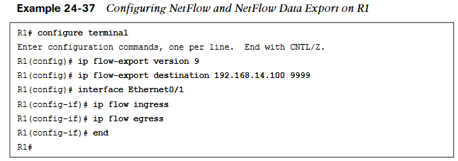
NetFlow and Flexible NetFlow Enable NetFlow
R1’s Ethernet0/1 interface for NetFlow Data Capture and exporting the data to the 192.168.14.100 collector. Example 24-37 illustrates the process of configuring NetFlow Data Capture and NetFlow Data Export on R1.
To verify that NetFlow and NetFlow Data Export were configured properly, a few commands can be run. The first is show ip flow interface, which shows the interfaces that are configured for NetFlow. The second is show ip flow, which shows the destination for the NetFlow data to be exported to. Finally, show ip cache flow shows the traffic flows that NetFlow is capturing.

Slide 44
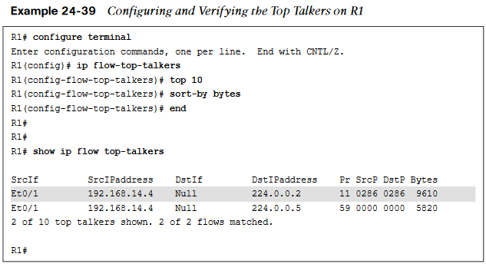
NetFlow and Flexible NetFlow Configuring and Verifying the Top Talkers on R1
NetFlow is able to configure the top specified number of talkers on the network.
A very useful and quick configuration allows you to gain a great snapshot of what is going on in a device from a flow perspective.
This view can be enabled by issuing the global configuration mode command ip flow-top-talkers and configuring the top command for the number of talkers (1–200) and the sort-by command to sort by bytes or packets, depending on the use case.

Slide 45
NetFlow and Flexible NetFlow Flexible NetFlow
Flexible NetFlow was created to aid in more complex traffic analysis configuration than is possible with traditional NetFlow.
Flexible NetFlow allows for the use and reuse of configuration components.
Flexible NetFlow allows for the use of multiple flow monitors on the same traffic at the same time. This means that multiple different flow policies can be applied to the same traffic as it flows through a device.
Table 24-9 Flexible NetFlow Components
Component Name | Description
Flow Records | Combination of key and non-key fields. There are predefined and user-defined records.
Flow Monitors | Applied to the interface to perform network traffic monitor
Flow Exporters | Exports NetFlow Version 9 data from the Flow Monitor cache to a remote host or NetFlow collector.
Flow Samplers | Samples partial NetFlow data rather than analyzing all NetFlow data.

Slide 46
NetFlow and Flexible NetFlow Sampled NetFlow Data Trade-offs
There are trade-offs in using sampled NetFlow data.
The biggest one is that there is a reduced load on the device in terms of memory and CPU. However, by sampling NetFlow data only at specific intervals, something could be missed as the accuracy goes down with sampling compared to when gathering all data.
Security has been a huge driver in the adoption of Flexible NetFlow due to its ability to track all parts of the IP header, as well as the packet and normalize it into flows.
Flexible NetFlow can dynamically create individual caches for each type of flow.
Flexible NetFlow can filter ingress traffic destined to a single destination.
You can use the collect and match commands to create a customized flow record.
To create a custom flow record, certain key and non-key fields must be matched so the flow record is usable. The match command is used to select key fields, and the collect command is used to select non-key fields.

Slide 47
NetFlow and Flexible NetFlow Flow Record Key and Non-Key Fields
Table 24-10 shows a list of the key and non-key fields that can be used to mimic the original NetFlow capabilities when building a custom flow record.
Table 24-10 Flow Record Key and Non-Key Fields
Field | Key or Non-Key Field | Definition
IP ToS | Key | Value in the type of service (ToS)
IP ToS | Key | Value in the IP protocol field
IP source address | Key | IP source address
Transport source port | Key | IP destination address
Transport destination port | Key | Value of the transport layer source port field
Interface input | Key | Value of the transport layer destination port
Flow sampler ID | Key | ID number of the flow sampler (if flow sampling is enabled)

Slide 48
NetFlow and Flexible NetFlow Flow Record Key and Non-Key Fields (Cont.)
Field | Key or Non-Key Field | Definition
IP source AS | Non-key | Source autonomous system
IP destination AS | Non-key | Destination autonomous system number
IP next-hop address | Non-key | IP address of the next hop
IP source mask | Non-key | Mask for the IP source address
IP destination mask | Non-key | Mask for the IP destination address
TCP flags | Non-key | Value in the TCP flag
Interface output | Non-key | Interface on which the traffic is transmitted
Counter bytes | Non-key | Number of bytes seen in the flow
Counter packets | Non-key | Number of packets seen in the flow
Time stamp system uptime first | Non-key | System uptime (time, in milliseconds)
Time stamp system uptime last | Non-key | System uptime (time, in milliseconds)

Slide 49
NetFlow and Flexible NetFlow Configuring Flow Records
Configuring flow records is an important step in enabling Flexible NetFlow. because the flow record defines what type of traffic will be analyzed or monitored.
There are predefined flow records, and you can also create custom flow records.
Custom flow records can have hundreds of different combinations to meet the exact needs of the business.
Configuring a custom flow record involves the following steps:
1. Define the flow record name.
2. Set a useful description of the flow record.
3. Set match criteria for key fields.
4. Define non-key fields to be collected.

Slide 50
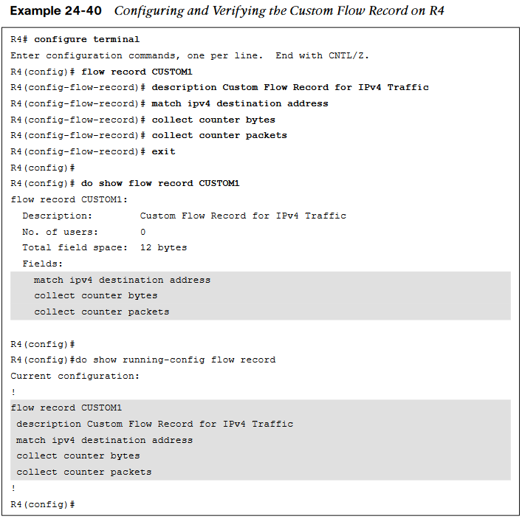
NetFlow and Flexible NetFlow Configuring the Custom Flow Record
Although many of the predefined flow records that are available may be suitable for many use cases, there are too many of them to cover here.
Having the ability to build a custom flow record for a specific and unique use case makes it extremely powerful.
Example 24-40 shows a custom flow record called CUSTOM1.

Slide 51
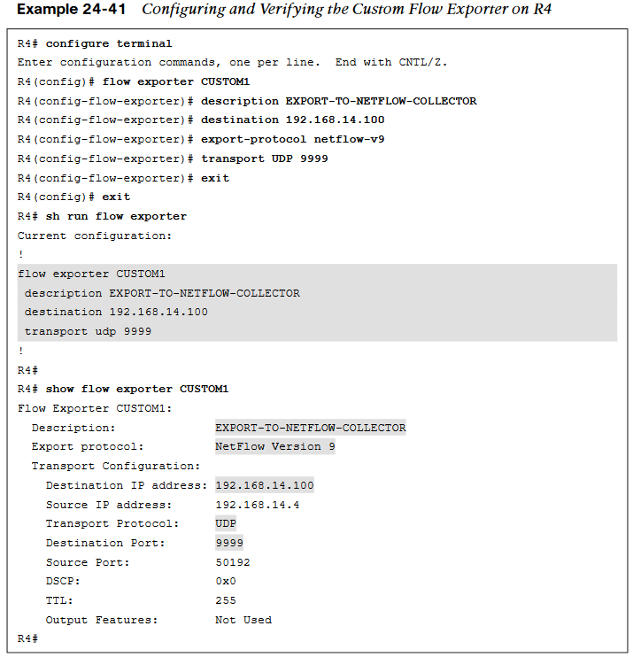
NetFlow and Flexible NetFlow Configuring the Custom Flow Exporter
Now that a custom flow record has been configured, the flow exporter can be created.
There are a few important steps to complete when building a flow exporter:
1. Define the flow exporter name.
2. Set a useful description of the flow exporter.
3. Specify the destination of the flow exporter to be used.
4. Specify NetFlow version to export.
5. Specify the UDP port.
Example 24-41 illustrates the configuration of the flow exporter as well as how to verify the configuration.

Slide 52
NetFlow and Flexible NetFlow Configure a Flow Monitor
Now that a custom flow exporter has been configured, the flow monitor must be created.
Each flow monitor requires a flow record to be assigned to it.
Each flow monitor has its own cache, and the flow record provides the layout and how to carve up the cache for the defined traffic defined in the flow record.
To configure a flow monitor, the following high-level steps must be taken:
1. Define the flow monitor name.
2. Set a useful description of the flow monitor.
3. Specify the flow record to be used.
4. Specify a cache timeout of 60 for active connections.
5. Assign the exporter to the monitor.
The cache timeout tells the device to export the cache to the collector every 60 seconds. It is important when creating a flow monitor for the description of the flow monitor to be useful and to map back to the flow record.

Slide 53
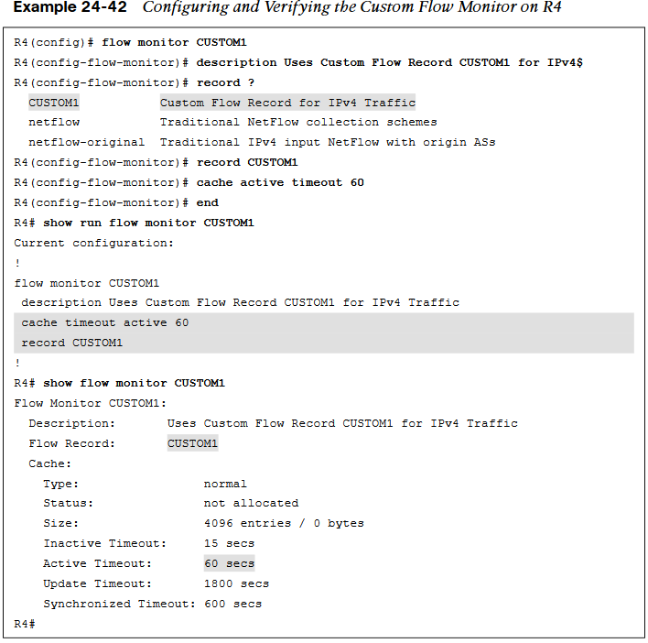
NetFlow and Flexible NetFlow Configuring the Custom Flow Monitor
When configuring QoS, it is nice to have the descriptions self-document the intent of what the policy is doing.
This helps when configuring the flow monitor and when using context sensitive help, as the description that is configured shows in the output.
Example 24-42 shows this as well as the configuration and verification for the flow monitor called CUSTOM1.

Slide 54
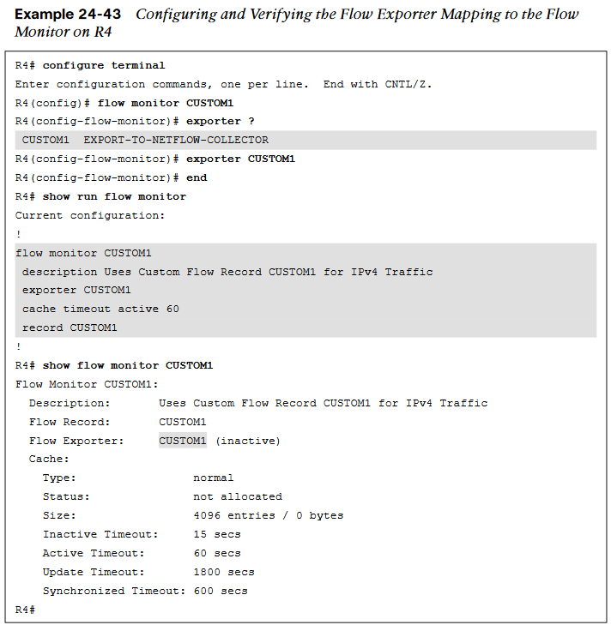
NetFlow and Flexible NetFlow Configuring the Flow Exporter Mapping
The next step is to map the flow exporter CUSTOM1 to the flow monitor CUSTOM1.
You need to essentially map the two together so the traffic that is being collected by the flow record can be exported to the NetFlow collector at 192.168.14.100.
Example 24-43 shows the process and verification for adding the flow exporter CUSTOM1 to the flow monitor CUSTOM1 on R4.

Slide 55
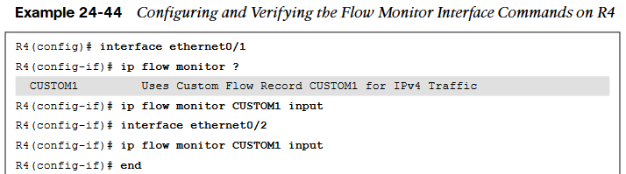
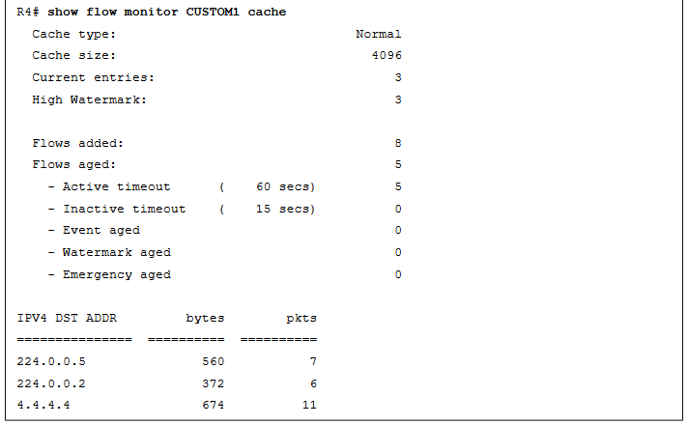
NetFlow and Flexible NetFlow Configuring the Flow Monitor Interface
The final step necessary in enabling Flexible NetFlow is to apply the flow monitor to the interfaces.
This step turns on the collection of NetFlow statistics, and it can be enabled for ingress or egress or both.
Example 24-44 illustrates the process as well as how to verify that Flexible NetFlow is working by issuing the show ip flow monitor CUSTOM1 cache command.

Slide 56
Switched Port Analyzer (SPAN) Technologies
When the problem appears to be a Layer 2 issue, there are a few options:
Insert a splitter between the devices.
Configure the network device to mirror the packets.
Insert a switch between the two devices and then configure the switch to mirror the transient traffic to a traffic analyzer.
Catalyst switches provide the Switched Port Analyzer (SPAN), which makes it possible to capture packets using the second two options above by using the following techniques:

Slide 57
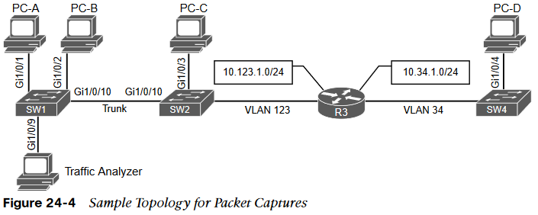
Switched Port Analyzer (SPAN) Technologies Sample Topology for Packet Captures
Figure 24-4 shows a sample topology with four computers (PC-A, PC-B, PC-C, and PC-D) spread across three switches and a traffic analyzer connected to SW1. PC-A, PC-B, and PC-C are all connected to VLAN 123 on the 10.123.1.0/24 network, and PC-D is connected to VLAN 34, which is on the 10.34.1.0/24 network. This topology is used to demonstrate the concepts of SPAN, RSPAN, and ERSPAN.

Slide 58
Switched Port Analyzer (SPAN) Technologies Local SPAN
A local SPAN session is the most basic form of packet capture as all the configuration occurs on a single switch. The destination of the mirrored traffic can be one or more local ports. The source of the packet capture can be only one of the following:
One or more specific switch ports
A port channel (also known as an EtherChannel)
A VLAN
Also consider the following:
Most switches support at least two SPAN sessions, but newer hardware can support more than two sessions.
The source port cannot be reused between two different SPAN sessions.
Source ports can be switched or routed ports.
The destination cannot be reused between two different SPAN sessions.
It is possible to saturate the destination port if the source ports are receiving more data than the destination port can transmit.

Slide 59
Switched Port Analyzer (SPAN) Technologies Specifying the Source Ports
The source ports are defined with the global configuration command monitor session session-id source {interface interface-id | vlan vlan-id} [rx | tx | both]. The SPAN session-id allows for the switch to correlate the source ports to specific destination ports.
The direction of the traffic can be specified as part of the configuration. With the optional rx keyword you capture only traffic received on that source, with the optional tx key word you capture traffic sent by that source, and with the both keyword you capture all traffic.
You can specify a trunk port as a source port to capture traffic for all VLANs that traverse that port. This might provide too much data and add noise to the traffic analysis tool. The VLANs can be filtered on the capture with the command monitor session session-id filter vlan vlan-range.

Slide 60
Switched Port Analyzer (SPAN) Technologies Specifying the Destination Ports
The destination port is specified with the global configuration command:
monitor session session-id destination interface interface-id [encapsulation {dot1q [ingress {dot1q vlan vlan-id | untagged vlan vlan-id | vlan vlan-id} | replicate [ingress {dot1q vlan vlan-id | untagged vlan vlan-id]}} | ingress]
As you can see, there are a lot of different nested options.
A SPAN session normally copies the packets without including any 802.1Q VLAN tags or Layer 2 protocols. Using the encapsulation replicate keywords includes that information. The full global configuration command is:
monitor session session-id destination interface interface-id [encapsulation replicate]

Slide 61
Switched Port Analyzer (SPAN) Technologies Specifying the Destination Ports (Cont.)
If the traffic analyzer is a Windows PC and is accessed using RDP, the port must be able to send and receive traffic for the Windows PC in addition to the traffic from the SPAN session. Situations like this require the following global configuration command:
monitor session session-id destination interface interface-id ingress {dot1q vlan vlan-id | untagged vlan vlan-id}
Selecting the dot1q keyword requires the packets to be encapsulated with the specified VLAN ID. Selecting the untagged keyword accepts incoming packets and associates them to the specified VLAN ID.
STP is disabled on the destination port to prevent extra BPDUs from being included in the network analysis. Great care should be taken to prevent a forwarding loop on this port.

Slide 62

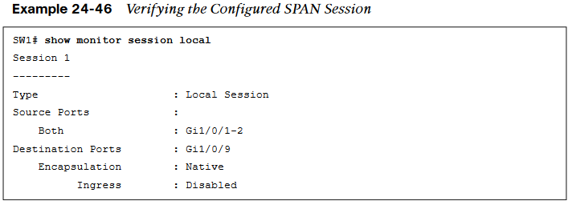
Switched Port Analyzer (SPAN) Technologies Local SPAN Configuration Examples
Example 24-45 shows how to monitor both PC-A’s and PC-B’s communication on SW1 and send it toward the local traffic analyzer.
A specific SPAN session can be viewed, or the output can be restricted to the local SPAN session, as shown in Example 24-46.

Slide 63
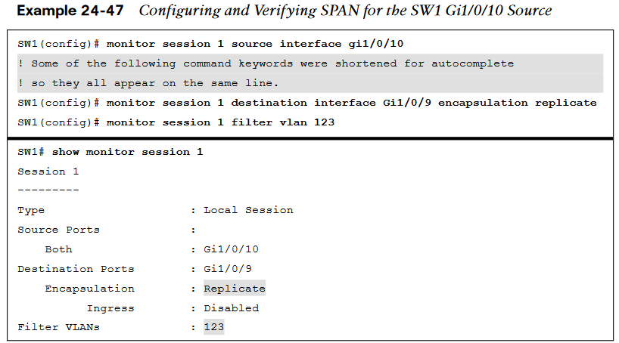
Switched Port Analyzer (SPAN) Technologies Local SPAN Configuration Examples (Cont.)
The next example illustrates monitoring the trunk port Gi1/0/10 and provides the output to PC-B for PC-A and PC-B communication on SW1 and sending it toward the local traffic analyzer.
Example 24-47 shows the commands that are entered on SW1 and then shows the configuration verified by examining the SPAN session.

Slide 64
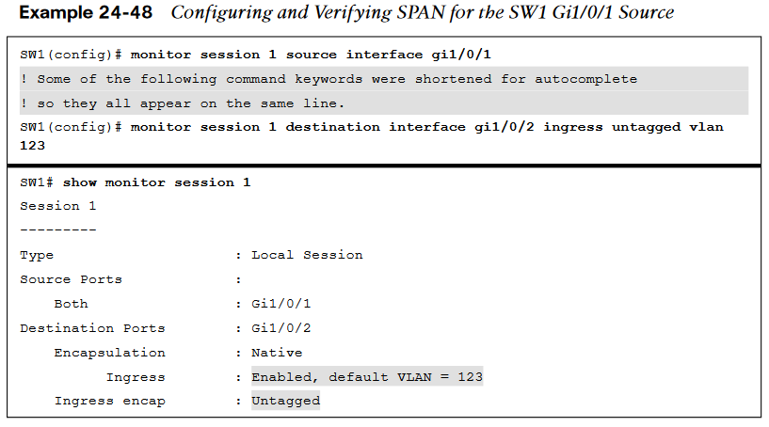
Switched Port Analyzer (SPAN) Technologies Local SPAN Configuration Examples (Cont.)
In the last scenario, the switch is configured to monitor PC-A’s traffic, and it uses an already installed network traffic analysis tool on PC-B.
When the switch is configured, PC-B can be accessed remotely to view the network traffic by using RDP.
Example 24-48 lists the commands that are entered on SW1 to capture the ingress traffic and shows the configuration being verified.

Slide 65
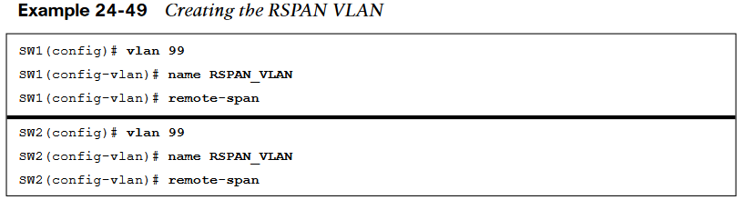
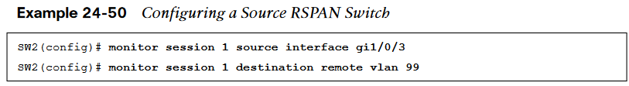
Switched Port Analyzer (SPAN) Technologies Remote SPAN (RSPAN)
In large environments, it might be not be possible to move a network analyzer to other parts of the network. Example 24-49 shows the RSPAN VLAN being created on SW1 and SW2.
Example 24-50 shows the configuration of RSPAN on the source switch, SW2. Traffic from PC-C is sent to SW1 for analysis.

Slide 66
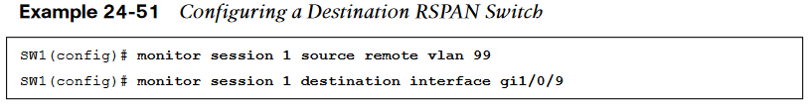
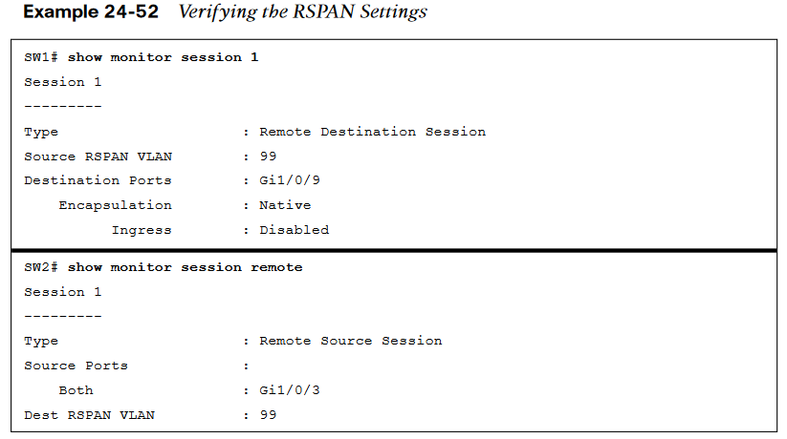
Switched Port Analyzer (SPAN) Technologies Configuration of RSPAN on the Destination Switch
Example 24-51 shows the configuration of RSPAN on the destination switch, SW1. The traffic is sent to the traffic analyzer for analysis.
Example 24-52 verifies the configuration of RSPAN on both SW1 and SW2.

Slide 67
Switched Port Analyzer (SPAN) Technologies Encapsulated Remote SPAN (ERSPAN)
In large environments, it might not be possible to move a network analyzer to other parts of the network. ERSPAN provides the ability to monitor traffic in one area of the network and route the SPAN traffic to a traffic analyzer in another area of the network through Layer 3 routing.
Specifying the Source Ports
A source and destination must be configured. To configure a source, the following command is issued: monitor session span-session-number type erspan-source. This defines the session number as well as the session type, erspan-source.
Once the initial session is created, the source must be defined in the session. This is accomplished by issuing the source { interface type number | vlan vlan-ID } [ , | - | both | rx | tx ] command.

Slide 68
Switched Port Analyzer (SPAN) Technologies Encapsulated Remote SPAN (ERSPAN) (Cont.)
When the source has been configured, it is necessary to configure the destination of the ERSPAN session. To enter the destination subconfiguration mode, the destination command is used. The rest of the commands will be issued in the destination subconfiguration mode to specify the destination of the ERSPAN session as well as any parameters associated with the configuration of the destination.
The next step is to identify the IP address of the destination for the ERSPAN session. Because this is a Layer 3 SPAN session, this IP address is where the traffic will be sent to be analyzed. The command to configure this action is simply ip address ip-address.
The final step is to assign a ToS or TTL to the ERSPAN traffic. This is done with the erspan { tos tos-value | ttl ttl-value } command from global configuration mode.

Slide 69
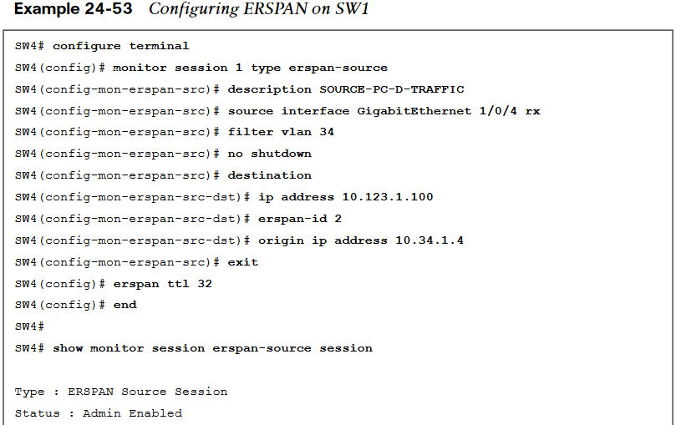
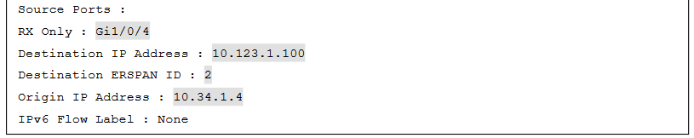
Switched Port Analyzer (SPAN) Technologies ERSPAN Process
Example 24-53 illustrates this whole process. In addition, to verify the configured sessions, the show monitor session erspan-source session is issued on SW1.

Slide 70
IP SLA
IP SLA is a tool built into Cisco IOS software that allows for the continuous monitoring of various aspects of the network.

Slide 71
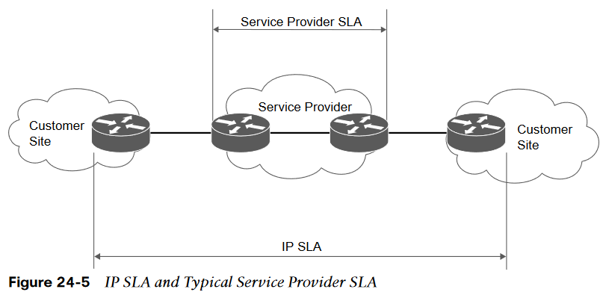
IP SLA IP SLA and Typical Service Provider SLA
Typically, any SLA received from a service provider only monitors or guarantees the traffic as it flows across the service provider’s network. Figure 24-5 shows this scenario and illustrates why IP SLA provides more visibility that a typical service provider SLA.

Slide 72
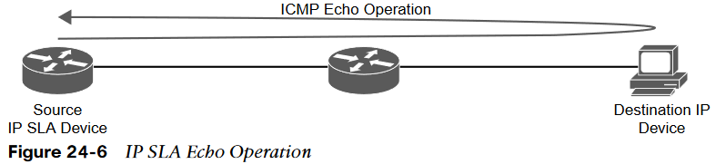
IP SLA IP SLA Echo Operation
Although there are many different options and probes available for IP SLA, this section focuses only on the ICMP echo and HTTP operations of IP SLA. The ICMP echo operation can functionally be thought of as testing reachability by leveraging ICMP echo and echo replies or pings. Figure 24-6 illustrates how the ICMP echo operation works in IP SLA.

Slide 73
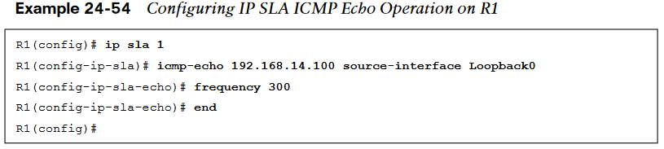
IP SLA Configuring IP SLA ICMP Echo Operation on R1
To configure any IP SLA operation, the ip sla operation-number command must be used to enter IP SLA configuration mode, where operation-number is the configuration for the individual IP SLA probe. Once in IP SLA configuration mode, the command icmp-echo {destination-ip-address | destination-hostname} [source-ip {ip-address | hostname} | source-interface interface-name] is used to configure the destination IP address of the device or host to be monitored.
The next step is to specify how often the ICMP echo operation should run. This is accomplished by issuing the frequency seconds command. Example 24-54 shows the process covered so far on R1.

Slide 74
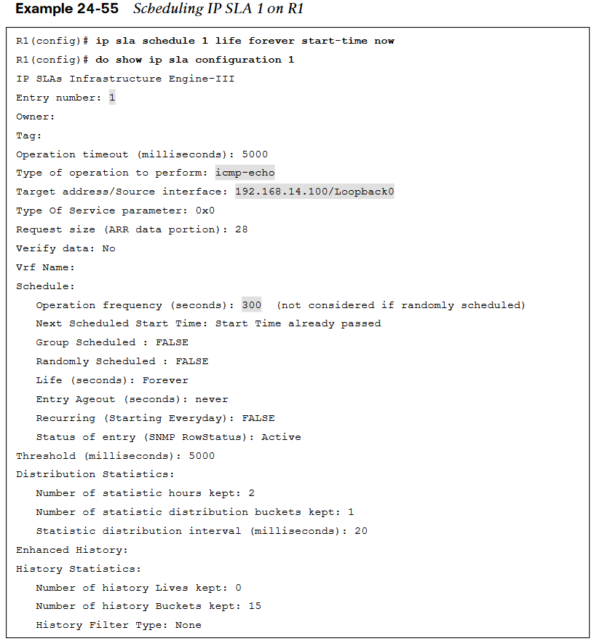
IP SLA Scheduling IP SLA 1 on R1
When the IP SLA configuration is complete, an important step is to schedule and activate the IP SLA operation that has been configured. This is where the ip sla schedule operation-number [life {forever | seconds}] [start-time {[hh:mm:ss] [month day | day month] | pending | now | after hh:mm:ss}] [ageout seconds] [recurring] command comes into play.
When the IP SLA operation is scheduled, it can be verified with the show ip sla configuration command.
Example 24-55 illustrates the configuration steps to schedule the IP SLA 1 operation with a start time of now and a lifetime of forever.

Slide 75
IP SLA Configuring the IP SLA HTTP GET Operation
Another very common use case for IP SLA is to monitor HTTP destinations for operation. This can be done by using the HTTP GET operation of IP SLA. In order to configure this type of monitor, the ip sla operation-number command must be used to enter IP SLA configuration mode.
When the operation number is specified, the next step is to configure the HTTP GET probe by issuing the command http {get | raw} url[name-server ip-address] [version version-number] [source-ip {ip-address | hostname}] [source-port port-number] [cache {enable | disable}] [proxy proxy-url].
When the probe is configured, as with any other IP SLA operation, this operation needs to be scheduled by using the command ip sla schedule operation-number [life {forever | seconds}] [start-time {[hh:mm:ss] [month day | day month] | pending | now | after hh:mm:ss}] [ageout seconds] [recurring].

Slide 76
Cisco DNA Center Assurance
Security has become one the most important pieces of the network, and users expect a better experience.
Customers demand a simple way to manage Day 0–2 operations and require a scalable and simple approach to running the net-work.
Cisco DNA Center Assurance provides a tool for handling the most relevant customer requirements.

Slide 77
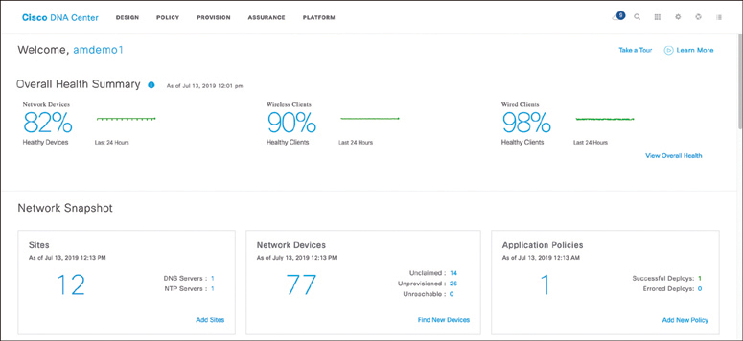
Cisco DNA Center Assurance Cisco DNA Center
Typically, when an issue arises in the network, a helpdesk ticket is created. However, by the time the network operations team gets the ticket assigned, the issue is either resolved on its own or the information provided in the ticket to assist with troubleshooting the issue is stale or out of date.
Cisco DNA Center Assurance has Network Time Travel. Network Time Travel acts as a digital video recorder (DVR) for the network. Network Time Travel records what is going on in the environment using streaming telemetry and can play back something that happened in the past.
Figure 24-7 shows the main Cisco DNA Center page.

Slide 78
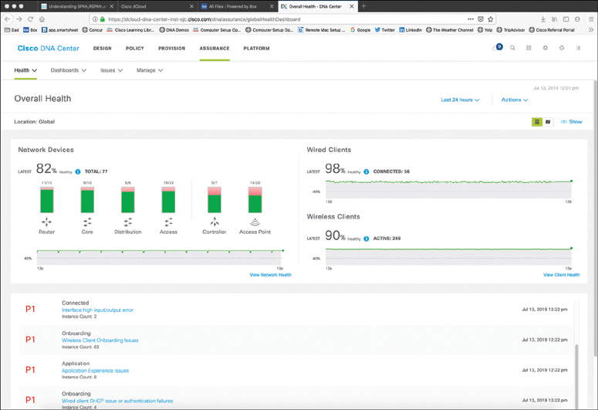
Cisco DNA Center Assurance Cisco DNA Assurance
Cisco DNA Assurance is part of Cisco DNA Center.
Assurance takes 30+ years of Cisco Technical Assistance Center (TAC) experience and puts it into a tool that uses machine learning to diagnose issues within a network.
In addition to finding and diagnosing the issues, Assurance gives guided remediation steps to fix the issue. The Assurance tab is shown in Figure 24-8.

Slide 79
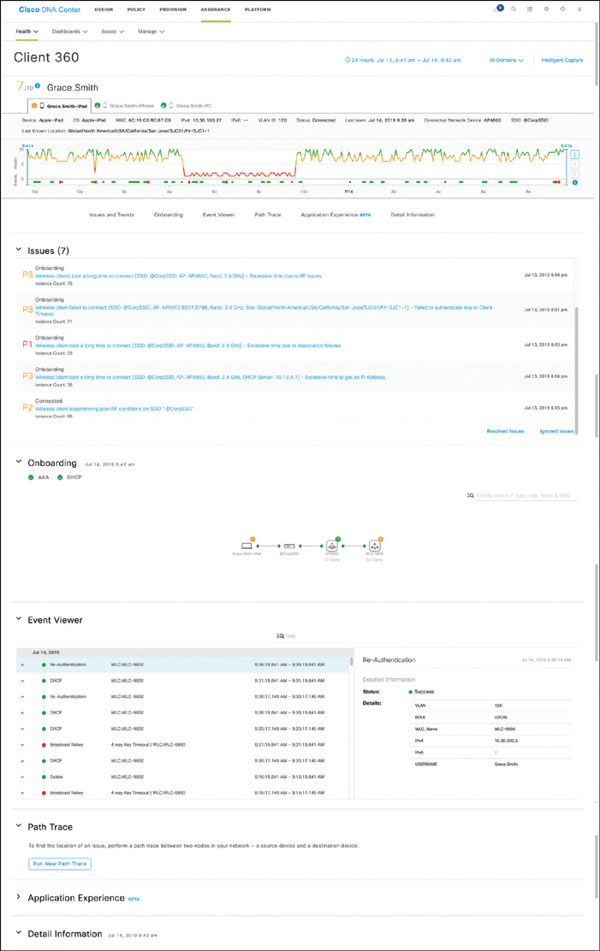
Cisco DNA Center Assurance Cisco DNA Center Client 360 View
From this view, you can do many different things.
You can click the user’s name to see details related to that specific user.
You can click each device to see specifics about that device in the Client 360 view.
Figure 24-10 shows the entire Client 360 view for the user Grace Smith.

Slide 80
Cisco DNA Center Assurance Cisco DNA Center Search Results
The amount of information that this screen provides is tremendous. The following pieces of information have been gathered automatically:
Device type
OS version
MAC address
IPv4 address
VLAN ID
Connectivity status
When the device was last seen on the network
What device it is connected to
Wireless SSID
Last known location
The timeline in the Client 360 view shows issues. This is also a Network Time Travel capability. Since Assurance records the telemetry, it is possible to search back in time to see exactly what has affected the user.

Slide 81
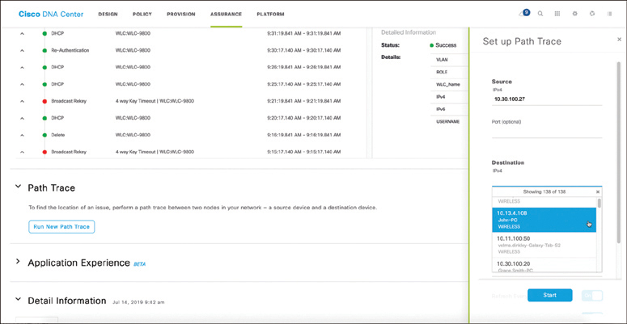
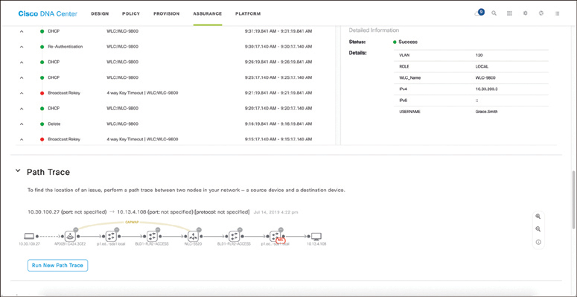
Cisco DNA Center Assurance Path Trace
The path trace output shows a topology view of the traceroute, and in this instance, Path Trace has also detected that there is an
access control list (ACL) blocking the traffic from Grace’s iPad to John’s PC (see Figure 24-12).
Assurance has a tool called Path Trace. Path Trace is a visual traceroute and diagnostic tool that can be run periodically or continuously, with a specific refresh interval.
Figure 24-11 Cisco DNA Center Assurance
Client 360 Path Trace
Figure 24-12 Cisco DNA Center Assurance
Client 360 Path Trace Output

Slide 82
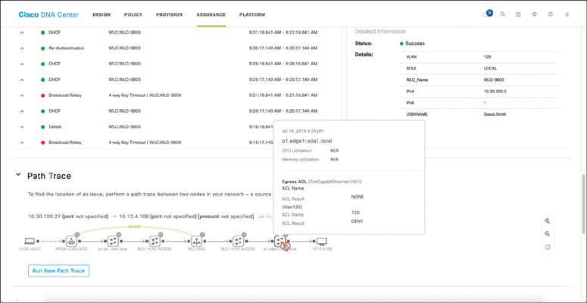
Cisco DNA Center Assurance Path Trace ACL Information
By hovering over the ACL entry, the following information can be seen:
The ACL’s name
The interface the ACL is applied to
The direction (ingress or egress)
The ACL result (permit or deny)
Figure 24-13 shows the access list information found in this example.

Slide 83

Cisco DNA Center Assurance Client 360 Issues
By clicking on one of the issues listed under Grace’s Client 360 view, such as the P1 Onboarding issue, a user can investigate the root cause of the issue.
Figure 24-14 shows the issues that are impacting Grace.

Slide 84

Cisco DNA Center Assurance Client 360 Root Cause and Remediation Steps
Figure 24-15 Cisco DNA Center Assurance Client 360
Root Cause and Guided Remediation Steps

Slide 85
Prepare for the Exam

Slide 86
Prepare for the Exam Key Topics for Chapter 24
Description
Using tools such as ping and extended ping | Leveraging NetFlow information to analyze traffic statistics
Using tools such as traceroute and extended traceroute | Understanding tools such as SPAN, RSPAN and ERSPAN for capturing network traffic
Troubleshooting using debugging and conditional debugging | Configuring tools such as SPAN, RSPAN, and ERSPAN to capture network traffic
OSPF Network Types and Hello/Dead Intervals | Leveraging on-box monitoring tools such as IP SLA to validate network and application performance
Using SNMP for monitoring and troubleshooting | Using DNA Center enhanced workflows to simplify design, provisioning, and troubleshooting of a network

Slide 87
Prepare for the Exam Key Terms for Chapter 24
Key Terms
ERSPAN
IP SLA
NetFlow
Path Trace
RSPAN
Simple Network Management Protocol (SNMP)
SPAN
syslog

